Slide 1
Object Oriented Programming in Java

Slide 2
Getting to know
Fatemeh Ziaeetabar (fziaeetabar@gwdg.de)
Research Interest:
(Deep) Machine Learning in Computer Vision
Human activity recognition
Video annotation
Semantic Scene Understanding
Spatio-temporal Reasoning
Robotics
Learning from Demonstration (LfD)
Cognitive robotics

Slide 3
References
Java How to Program (Early Objects) (10th Edition) by Paul J. Deitel, Harvey Deitel, Pearson Publication, 2015.
Objects First with Java: A Practical Introduction Using BlueJ (6th Edition) by David J. Barnes, Michael Kolling, Pearson Publication, 2017.
Object-Oriented Programming in C++ (4th Edition) by Robert Lafore, 1997 (first edition).

Slide 4
Grading
قسمت | نمره
آزمون میان ترم | ۳.۵
آزمون پایان ترم | ۶.۵
تمرین‌ها | ۲.۵
پروژه‌ها (میان‌ترم و نهایی) | ۴
کارگاه | ۳.۵
مجموع | ۲۰

Slide 5
Workshops
زمان
گروه ۱:‌ شنبه [۱۵-۱۷]
گروه ۲:‌ چهارشنبه [۱۵-۱۷]

Slide 6

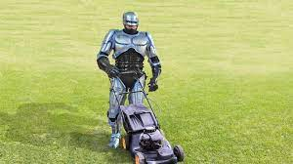
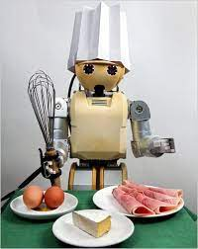
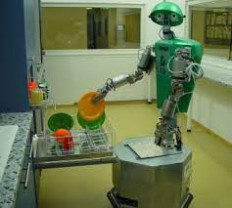
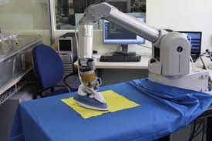
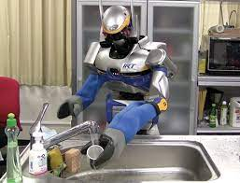

Slide 7


Please water the pots in my absence
Ich kann kochen

Slide 8
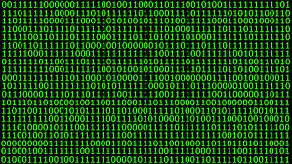
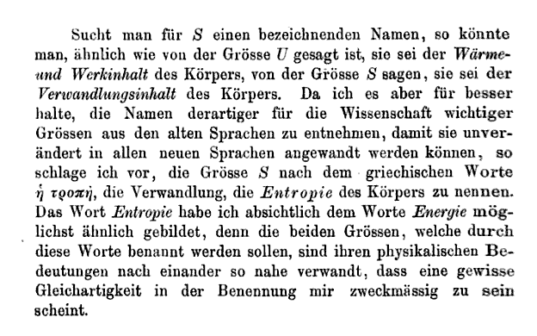
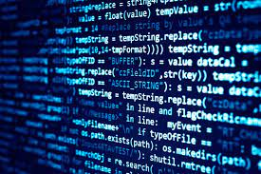


Computer Program

Slide 9
Computer Programming
Analysis
Developing understanding
Generating algorithms
Verification of requirements of the algorithm
Implementation of algorithm in target language (Coding)
O.O.P
Java

Slide 10
Coding | Programming
Process of writing instructions using a programming language for the computer to perform a task. Involves writing instructions using a suitable programming language Requires excellent knowledge of programming language syntax, structure and language standards A wider concept | Process of designing and building an executable computer program for accomplishing a specific computer task Involves identifying the problem, generating algorithms, analyzing the algorithm accuracy, implementing the algorithm using a programing language and testing Requires logical thinking, Problem-solving, analytical skill etc.

Slide 11
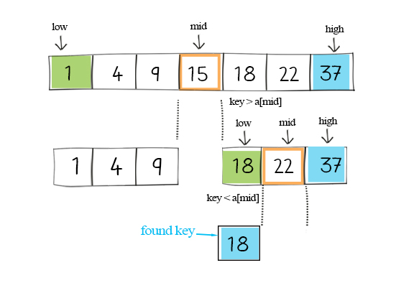
Binary Search
int main(void) {
int array[] = {1, 4, 9, 15, 18, 22, 37};
int n = sizeof(array) / sizeof(array[0]);
int x = 18;
int result = binarySearch(array, x, 0, n - 1);
if (result == -1)
printf("Not found");
else
printf("Element is found at index %d", result);
return 0;
}
// Binary Search in C
#include <stdio.h>
int binarySearch(int array[], int x, int low, int high) {
// Repeat until the pointers low and high meet each other
while (low <= high) {
int mid = low + (high - low) / 2;
if (array[mid] == x)
return mid;
if (array[mid] < x)
low = mid + 1;
else
high = mid - 1;
}
return -1;
}

Slide 12
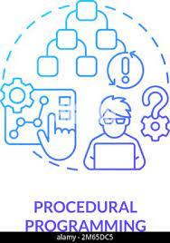
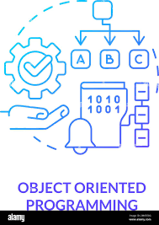
Why Do We Need Object-Oriented Programming?
Object-oriented programming was developed because limitations were discovered in earlier approaches to programming.
To appreciate what OOP does, we need to understand what these limitations are and how they arose from traditional programming languages.

Slide 13
Procedural Languages
C, Pascal, FORTRAN, and similar languages are procedural languages.
Each statement in the language tells the computer to do something.
The programmer creates the list of instructions, and the computer carries them out.
Add the numbers
Divide by six
Display the output
.
.
.

Slide 14
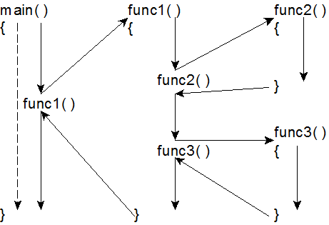
Division into Functions
When programs become larger, a single list of instructions becomes unwieldy.
The function was adopted as a way to make programs more comprehensible to their human creators.
…………
…………
…………
Call A
…………
Func. A
…………
…………
…………
…………
Call B
Func. B
main
…………
…………
…………
…………
Call C
Func. C
…………
…………
…………

Slide 15
…………
Dividing a program into functions and modules is one of the cornerstones of structured programming.
The somewhat loosely defined discipline that influenced programming organization for several decades before the advent of object-oriented programming.
Call A
Func. A
…………
Call B
Func. B
…………
Call C
Func. C
…………
Call D
Func. D
…………
Call E
Func. E
…………
Module

Slide 16
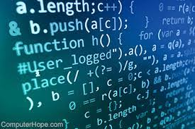
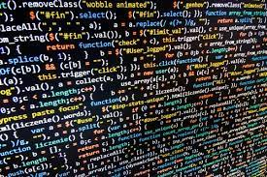
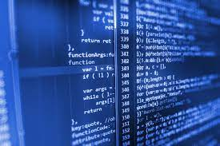
Problems with Structured Programming
Reason???
No matter how well the structured programming approach is implemented …
large programs become excessively complex.

Slide 17
Disadvantages of Structured Programming
Functions have unrestricted access to global data
Unrelated functions
and data, the basis of the procedural paradigm, provide a poor model of the real world

Slide 18
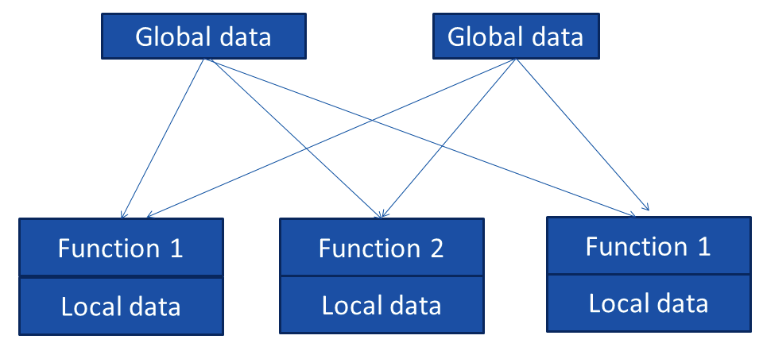


Unrestricted Access
Problems
???

Slide 19

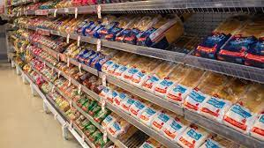
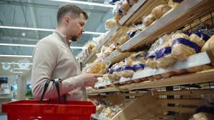
Suppose:
In an inventory program, someone may decide that the data items should be changed from 5 digits to 12 digits.
This may necessitate a change from a short to a long data type.
Now all the functions that operate on the data must be modified to deal with a long instead of a short.

Slide 20
Disadvantages of Structured Programming
Functions have unrestricted access to global data
Providing a poor model of the real world

Slide 21



Real-world Modelling
The arrangement of separate data and functions does a poor job of modeling things in the real world.
In the physical world we deal with entities such as people and objects.
Complex real-world objects have both attributes and behavior

Slide 22
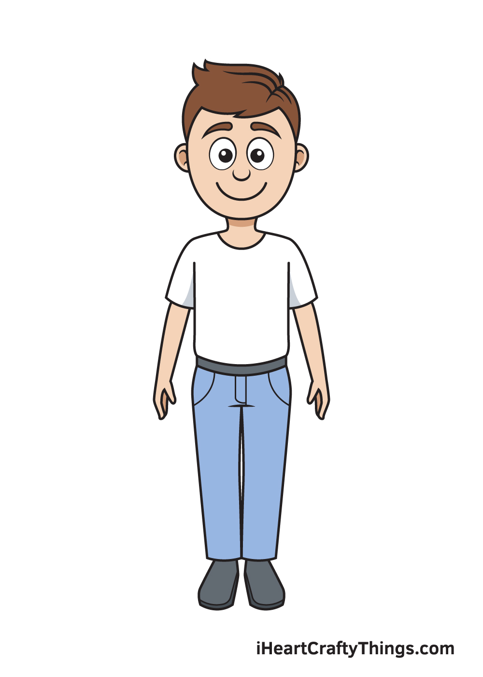

Attributes
Attribute
Eye color: brown
Height: 170 cm
Job title: Bank employee
Attribute
Horsepower: 180
Door numbers: 4
Attributes in the real world are equivalent to data in a program: They have a certain specific values, such as:
brown (for eye color),
four (for the number of doors).

Slide 23
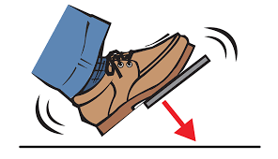
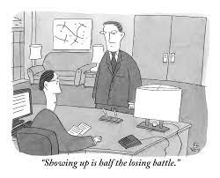

Behaviors
Behavior is something a real-world object does in response to some stimulus.
Applying car brakes
Ask for promotion
Yes or No!
Behavior is like a function: you call a function to do something for and it does it.
Car stops!

Slide 24
Object-oriented Programming
The fundamental idea behind object-oriented languages is to combine into a single unit both data and the functions that operate on that data.
Such a unit is called an object.
Functions
Object
Data and its functions are encapsulated into a single entity.
Data

Slide 25


Object-oriented Programming
Do you want to read a data?
The data is hidden!
What to do?
Calling a function member!
No other functions can access the data.
This simplifies writing, debugging, and maintaining the program.

Slide 26
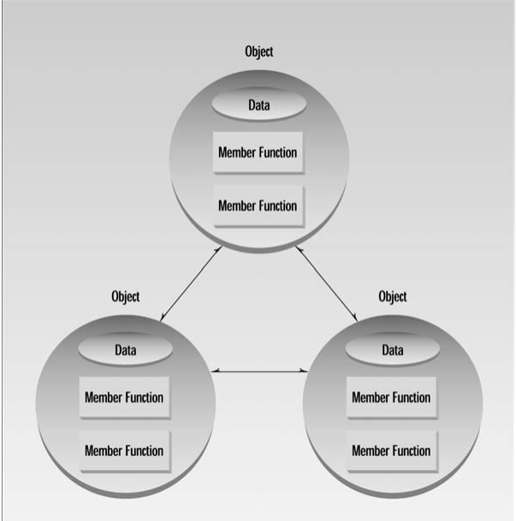
Object-oriented Programming
O.O.P typically consists of a number of objects, which communicate with each other by calling one another’s member functions.
O.O.P. 4th edition, Robert Lafore

Slide 27


An example:
Procedural Programming
Object-oriented Programming
Data: Food on the table
Food: Global data, as they are accessible by everyone.
Result: The mess!
Each small table is an object.
Each object has its own data and functions.
Each object can call another object’s function to access its content.
Result: Discipline!

Slide 28
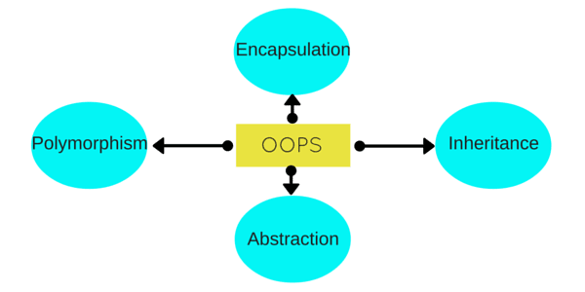
Principles of OOP
Combining data and methods together into one single unit as an object.
Allows objects to take on different forms. Makes code more flexible.
Allows certain classes to be under the umbrella of other classes (parent and child class).
Hides some of the complexity and unnecessary information from users to reduce programming complexity.

Slide 29
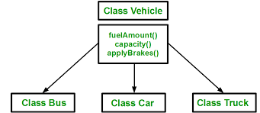
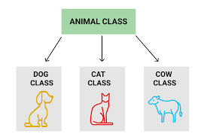
Inheritance
...
….
…
...
….
…
...
….
…

Slide 30
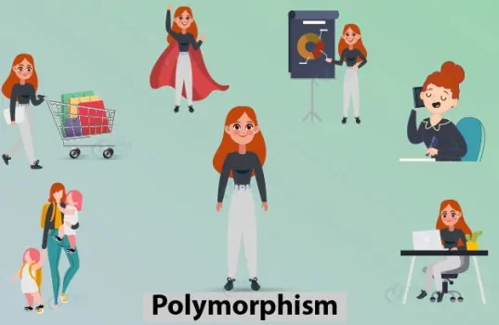
Polymorphism
A lady can be a mother, sister and friend at the same time.
This means that a person can show different behaviors in different situations.
Kids
Lady
Parents
Boss

Slide 31
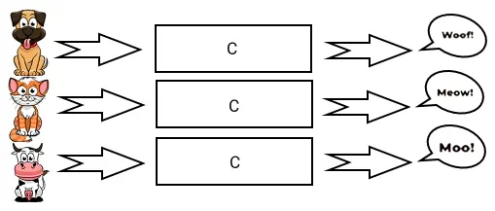
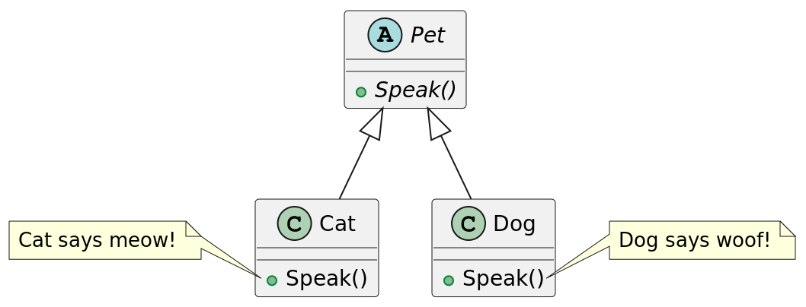
Polymorphism is the provision of a single interface to entities of different types

Slide 32
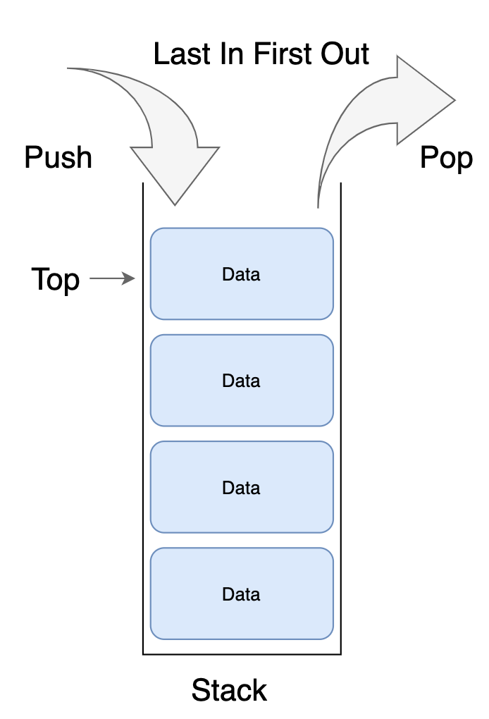
Polymorphism in Programming
We may have a program that requires three stack types:
A stack is used for integer values,
a stack for floating-point decimal values, and
another stack for characters.
Algorithm of implementation of stacks is the same despite the different types of values.
In procedural languages, three different routines should be created, one for each of the stacks.
In O.O.P., it is possible to create a set of routines with the same names.

Slide 33

Abstraction
You need to:
Know how to use your coffee machine to make coffee.
provide water and coffee beans,
Switch it on and
Select the kind of coffee you want to get.
Handling complexity by hiding unnecessary details from the user.
Using a coffee machine:
You DO NOT need to know:
how the coffee machine is working internally
The ideal temperature of the water or
The amount of ground coffee you need to use.

Slide 34
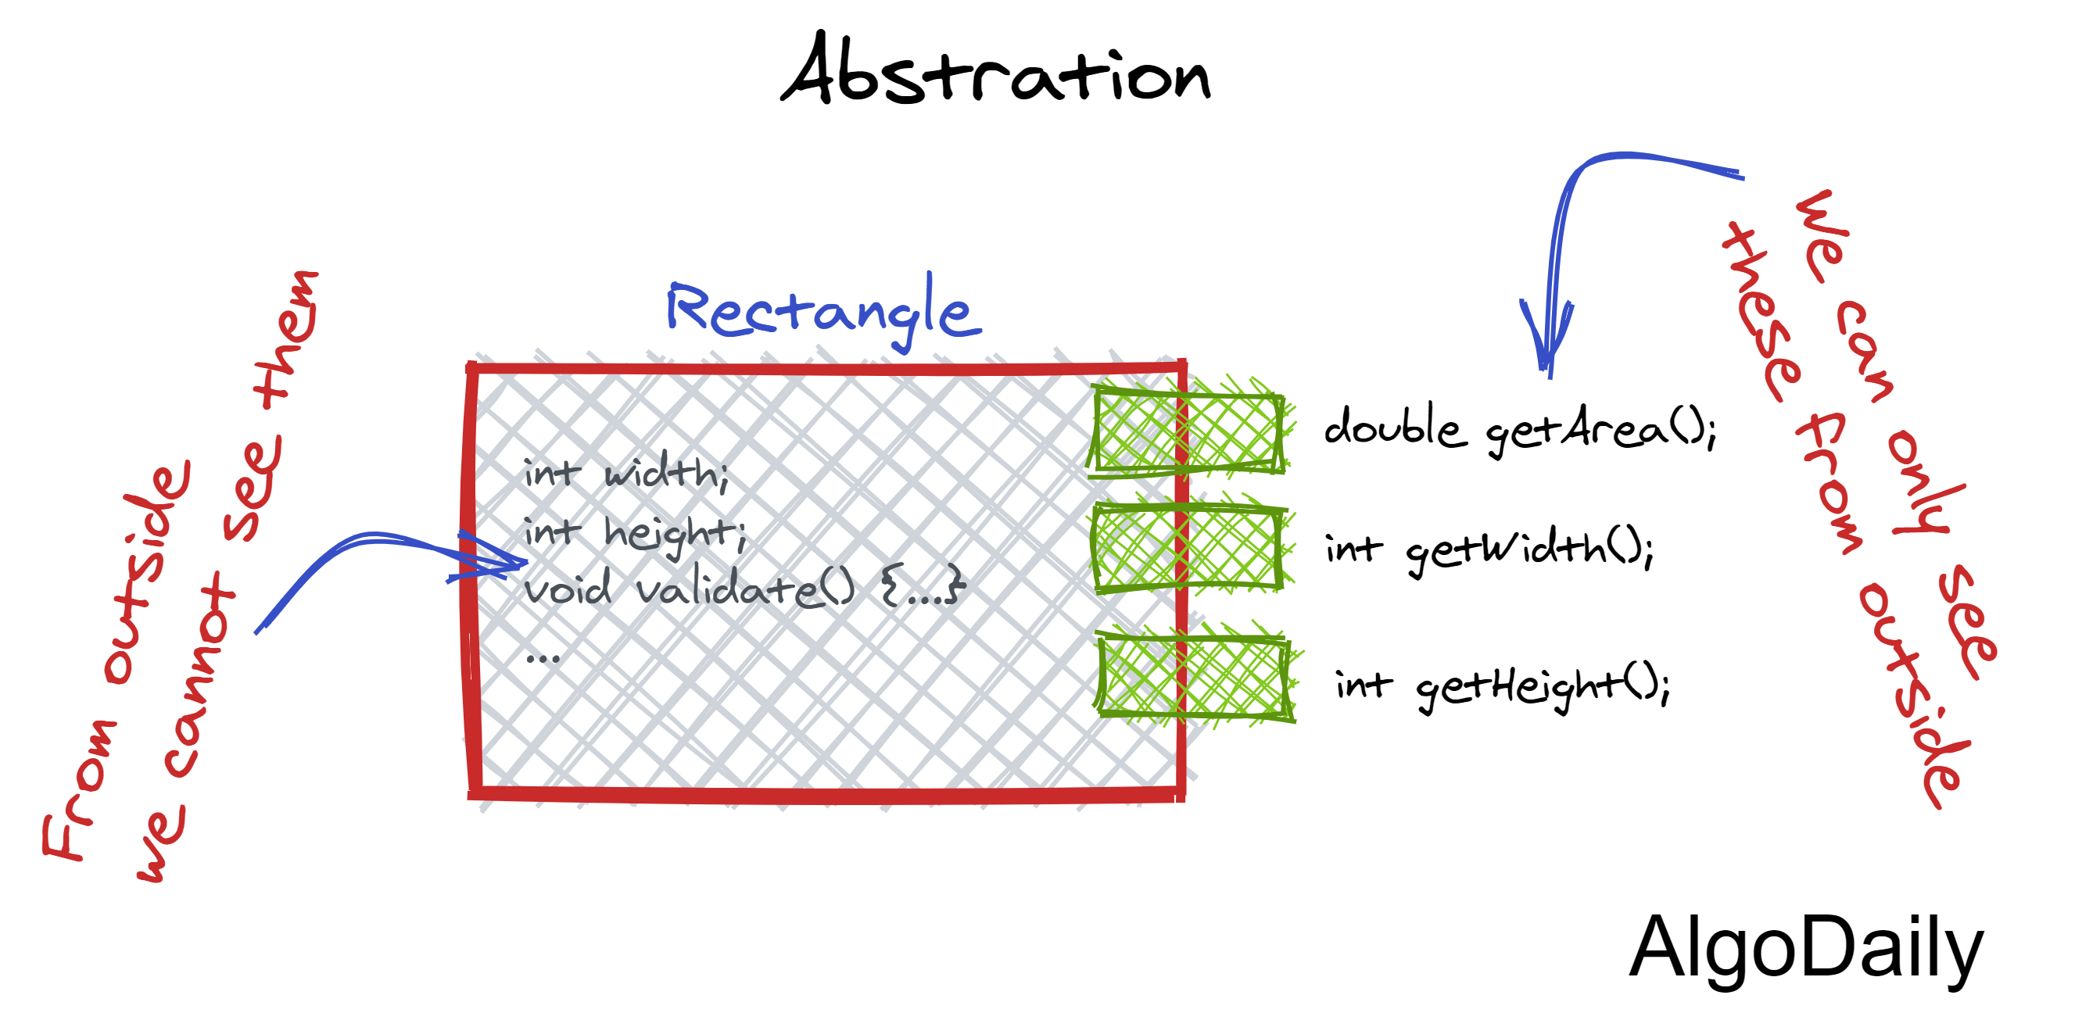
Abstraction in O.O.P
You need to know:
Which methods of the object are available to call
Which input parameters are needed to trigger a specific operation.
You DO NOT need to know:
How this method is implemented
Which kinds of actions it has to perform to create the expected result.

Slide 35
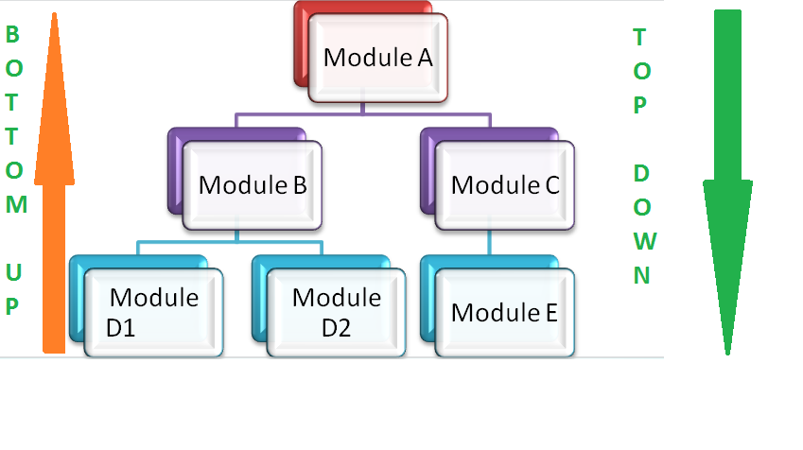
Top-down Vs. Bottom-up approach
Object-oriented language (C++ or java) uses a bottom-up approach where each object is identified first.
Procedural programming follows a top-down approach. It gives importance to the concept of the function and divides the large programs into smaller parts.

Slide 36
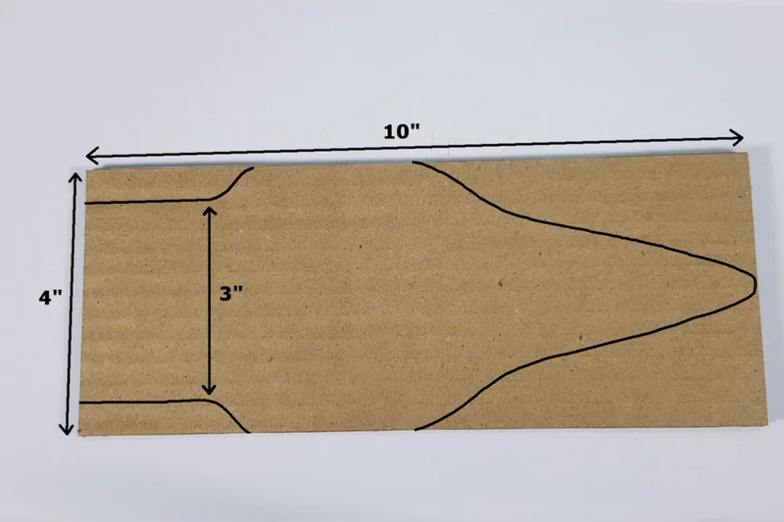

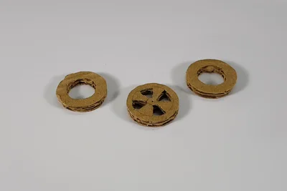

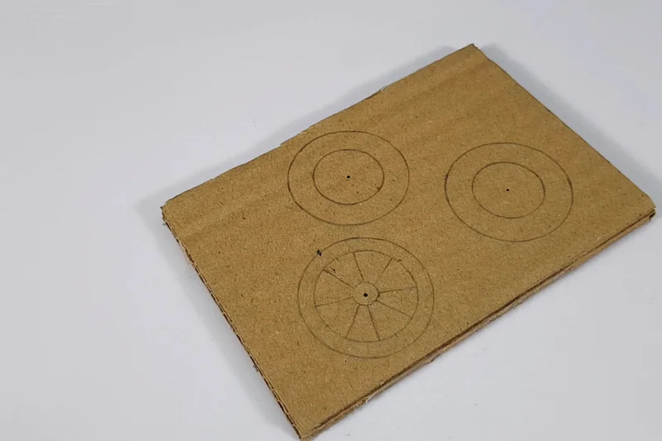

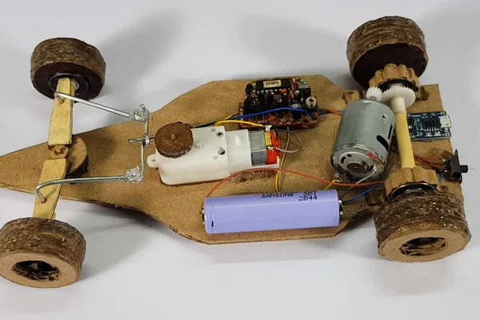
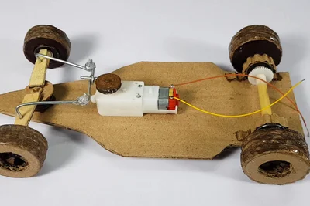
How to Make a Remote Control Car?
(2)
(4)
(1)
(3)
(5)
The bottom-up approach works by starting with individual components and building up to the larger system.
In a bottom-up approach, good intuition is needed.
(7)
(6)
(8)

Slide 37
SMS in an Online Market
Online Market
Sending Sys.
Opinion Sys.
Search Sys.
Customer Service Sys.
Financial Sys.
Payment by Card
Wallet
Short Massage

Slide 38
Object-Oriented Programming Languages
Python
C++
Java
Rubby
C#
PHP

Slide 39
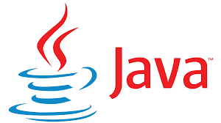

Java
Java is a general-purpose, object-oriented programming language that was designed by James Gosling at Sun Microsystems in 1991.
Java can be run on any platform using the Java Virtual Machine. Because of this, Java is also known as a WORA (Write Once, Run Anywhere) language.
In modern times, Java is one of the most popular programming languages.

Slide 40
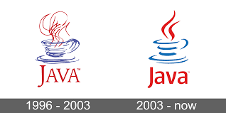
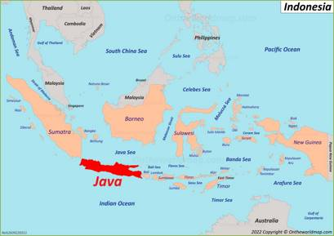
Java Logo
The concept behind this logo is that when the engineers were developing the programming language Java, they were consuming a lot of coffee named Java coffee beans.

Slide 41
Java’s Popularity
TIOBE raking 2023 Java = #4
https://www.tiobe.com/tiobe-index/
RedMonk ranking 2023 Java = #3
https://redmonk.com/sogrady/2021/08/05/language-rankings-6-21/
IEEE Spectrum ranking 2023 Java = #2
https://spectrum.ieee.org/top-programming-languages-2022
PYPL ranking 2023 Java = #2
http://pypl.github.io/PYPL.html

Slide 42
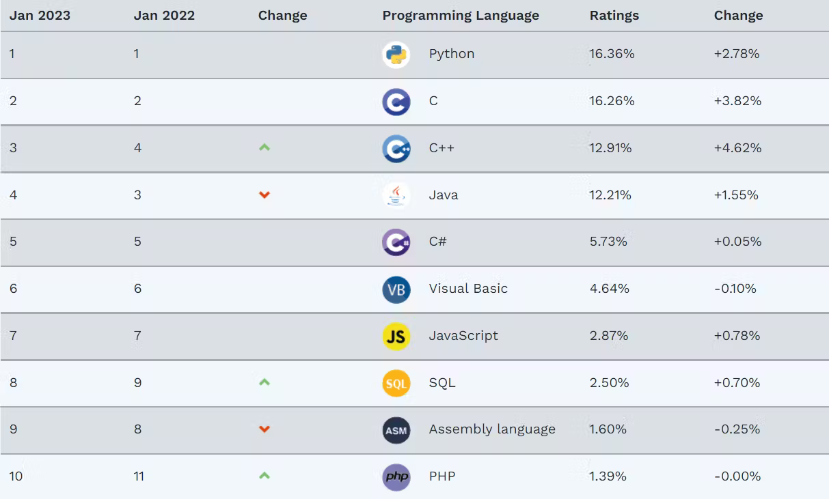
TIOBE Ranking 2023

Slide 43
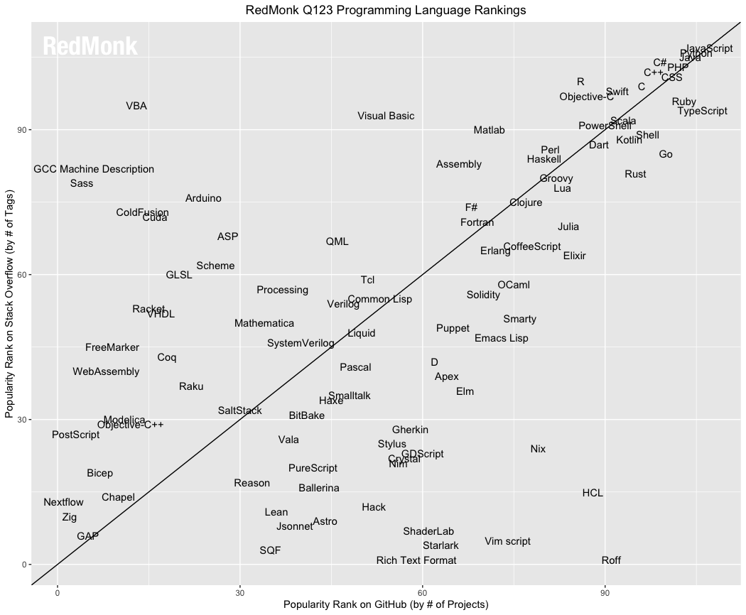
RedMonk ranking 2023

Slide 44
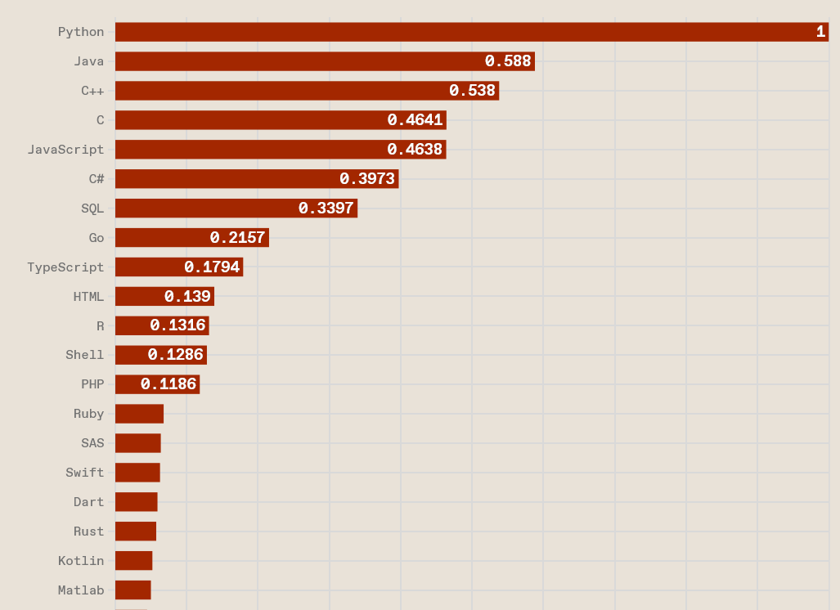
IEEE Spectrum Ranking 2023

Slide 45
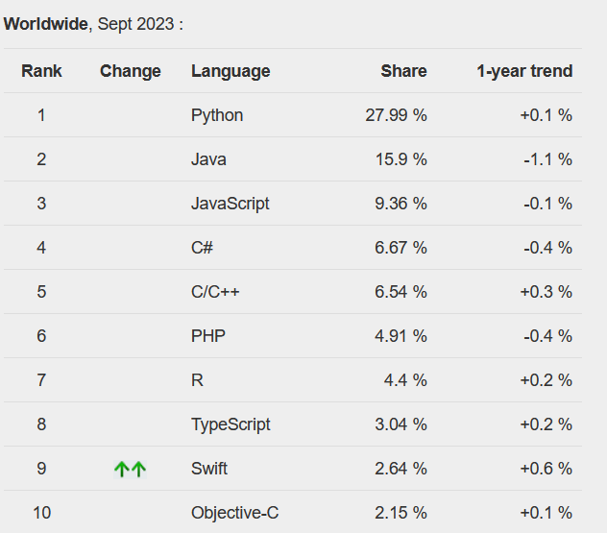
PYPL Ranking 2023

Slide 46
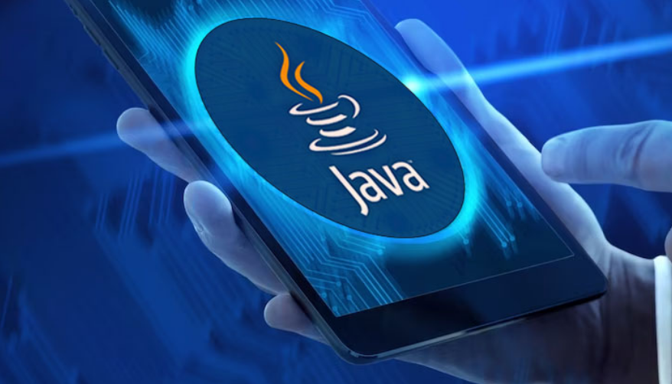
Top 10 Reasons to Learn Java
Java’s Popularity and High Salary
It is used by some 9 million developers and it runs on around 7 billion devices worldwide according to Oracle blogs.
2. Java is Easy to Learn
Java is quite easy to learn and can be understood in a short span of time as it has a syntax similar to English.
3. Java has a Large Community
There is a large online community of Java users ranging from beginner, intermediate, and even expert levels that are particularly helpful in case any support is required.

Slide 47
Top 10 Reasons to Learn Java
4. Java has an Abundant API
Java has an abundant Application Programming Interface (API) that includes many Java classes, packages, interfaces, etc.
This is useful for constructing applications without necessarily knowing their inside implementations.
Java has mainly three types of API i.e. Official Java core APIs, Optional official Java APIs, and Unofficial APIs.
These APIs overall are used for almost everything including networking, I/O, databases, media, XML parsing, speech synthesis, etc.

Slide 48
Top 10 Reasons to Learn Java
5. Java has Multiple Open-Source Libraries
There are multiple open-source libraries in Java such as JHipster, Maven, Google Guava, Apache Commons.
They can be copied, studied, changed, shared and make Java development easier, cheaper and faster.
6. Java has Powerful Development Tools
There are many Integrated development environments (IDEs) in Java such as Eclipse, NetBeans, IntelliJ IDEA that provide various facilities for software development to programmers.
Useful for debugging, syntax highlighting, code completion, language support,, etc. that make coding in Java easier and faster.

Slide 49
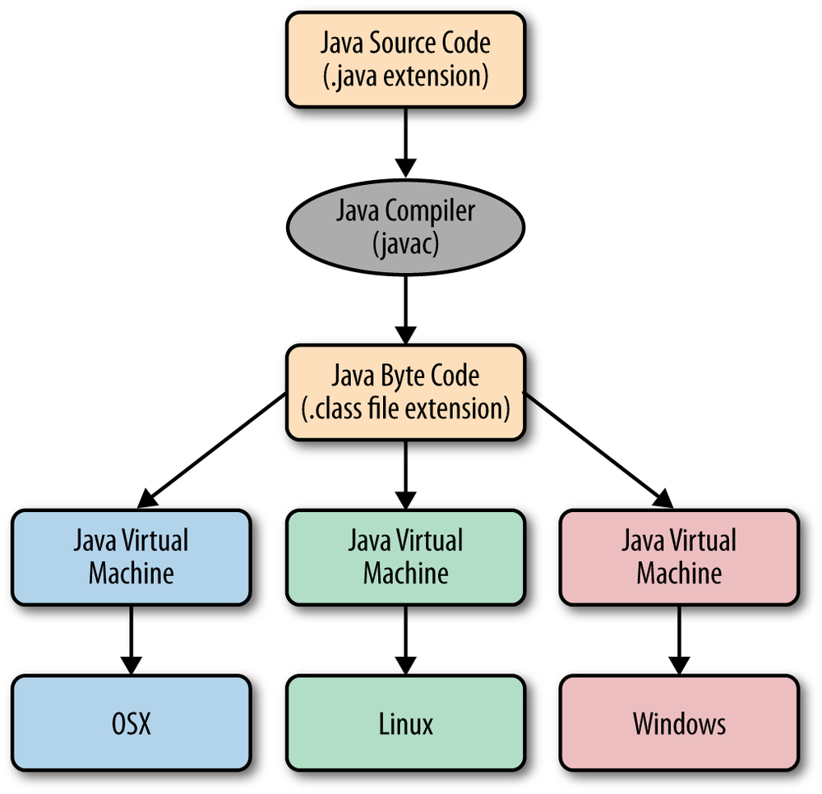
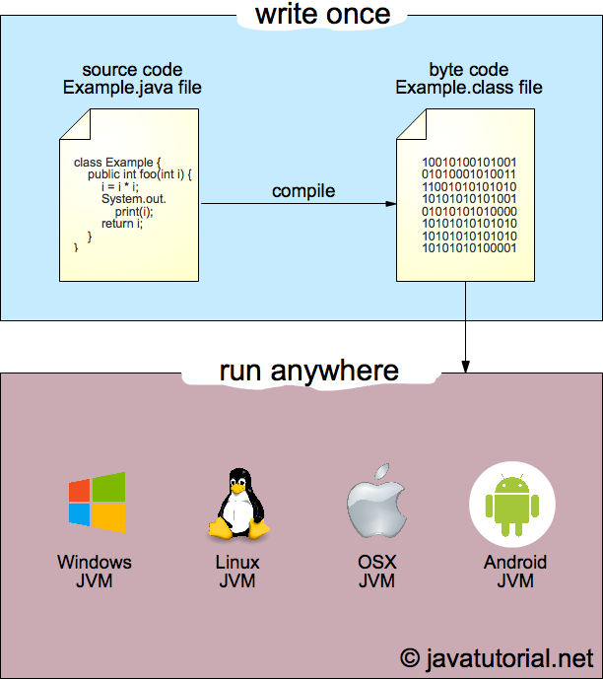
Java files
.java file extension
Compiled to
Java bytecode
.class file extension
Bytecode
Intermediate code
Runs on Java Virtual Machine (JVM)

Slide 50
Top 10 Reasons to Learn Java
7. Java is Free of Cost
It is available under the Oracle Binary Code License (BCL) free of charge.
This means that Java is free for development and test environments,
For commercial purposes, a little pay is required.
8. Java is Platform Independent
Java is platform-independent as the Java source code is converted to bytecode by the compiler which can then be executed on any platform using the Java Virtual Machine.

Slide 51
Top 10 Reasons to Learn Java
9. Java has Great Documentation Support
The documentation support for Java is excellent using Javadoc which is the documentation generator for Java.
10. Java is Versatile
Java is very versatile as it is used for programming applications on the web, mobile, desktop, etc. using different platforms.
Including features such as dynamic coding, multiple security features, platform-independent characteristics, network-centric designing, etc.

